Slide 1



CLINIC APPOINTMENTS &
PRESCRIPTION MANAGER
VAISHNAVI. K — 2620040020
S. AISHWARYA — 2620040059
N. HARSHITHA — 2620090115
Java-Based Healthcare Record & Appointment System

Slide 2

Abstract
PROJECT OVERVIEW
A menu-driven Java application to organize clinic appointments and basic prescription records.
• Stores patient and appointment details
• Helps staff view and search records
• Displays doctor details and consultation fees
• Supports prescription and medicine tracking
PROJECT OBJECTIVES
• Reduce manual record-keeping
• Make appointment information easier to retrieve
• Keep patient, doctor and visit data structured
• Demonstrate core Java programming concepts
Platform: Java console application
Users: Clinic staff/receptionist

Slide 3

Understanding Problem Statement
PROPOSED SOLUTION
A centralized Java program with a simple menu to:
1. Book and view appointments
2. Manage patient and doctor details
3. Record consultation/payment information
4. Create and view prescription details
5. Track medicines and feedback
Expected result: a clearer, faster clinic workflow.
PROBLEM STATEMENT
Manual clinic workflows can lead to:
• Appointment details being misplaced
• Slow patient-record lookup
• Repeated entry of patient information
• Difficulty tracking prescriptions
• Confusion about doctor availability and fees

Slide 4
CO 1 Topics
CO 1 — PROBLEM SOLVING
Computational thinking converts clinic needs into a sequence of steps.
INPUT
Patient ID, patient name, doctor, appointment type.
PROCESS
Validate details → select doctor → calculate fee → save record.
OUTPUT
Appointment confirmation and a formatted summary.
ALGORITHM (EXAMPLE)
1. Start the program
2. Display the main menu
3. Read the user's choice
4. Accept required patient details
5. Validate the entered information
6. Process the selected operation
7. Display the result
8. Repeat until Exit is selected

Slide 5

Co 2 TOPICS
CO 2 — CONTROL FLOW
Selection statements make decisions:
• if / if-else: validate ID and required fields
• switch: route the selected menu option
• loops: keep the application running
• break: exit a menu case
Example: if the patient ID is valid, continue booking; otherwise, show an error.
MENU FLOW
1 Book Appointment
2 View Appointments
3 Search Patient
4 Manage Prescription
5 Medicine Tracking
6 Review / Feedback
0 Exit
The menu repeats after each operation so staff can complete several tasks in one session.

Slide 6

CO 3 Topics
CO 3 — METHODS & ARRAYS
Methods divide the program into reusable tasks.
• bookAppointment()
• displayAppointments()
• searchPatient()
• calculateConsultationFee()
• displayPrescription()
Arrays or lists can hold multiple appointment records and support traversal, searching and counting.
WHY MODULAR DESIGN?
• Easier to read and explain
• Less repeated code
• Each method has one clear responsibility
• Simpler testing and debugging
Example: fee calculation is kept in its own method instead of placing all calculations inside main().

Slide 7
CO 4
CO 4 — OOP DESIGN
Suggested classes:
Patient
• patientId, patientName, phone
Doctor
• doctorName, specialization, fee
Appointment
• appointmentId, patient, doctor, date, status
Prescription
• prescriptionId, diagnosis, medicine, dosage
OOP CONCEPTS USED
• Classes and objects model real clinic entities
• Constructors initialize patient and appointment data
• Encapsulation keeps fields organized
• Method overloading can support different booking inputs
• Inheritance / overriding can extend appointment types
• try-catch can handle invalid input safely

Slide 8
CO 5
CO 5 — STRINGS & FILE I/O
String operations help validate and format records.
• equals() for ID / choice comparison
• trim() to remove extra spaces
• toUpperCase() for names or labels
• substring() to process text fields
File I/O can store and reload appointment and prescription records between program runs.
DATA HANDLING
Example record format:
Appointment ID: A101
Patient: Priya Sharma
Doctor: Dr. Rahul Sharma
Type: General Consultation
Fee: ₹500
Status: Booked
Records should be checked before saving and errors handled when a file is missing or unreadable.

Slide 9
CO 6
CO 6 — COLLECTIONS
Collections can manage changing numbers of records.
• ArrayList<Appointment> stores appointments
• HashMap<String, Patient> supports lookup by patient ID
• for-each loops display records
• Streams can filter appointments by doctor or status
Collections reduce the need to manage fixed-size arrays manually.
SAMPLE CLINIC DIRECTORY
Dr. Rahul Sharma — General Physician — ₹500
Dr. Priya Reddy — Dentist — ₹600
Dr. Arjun Rao — Cardiologist — ₹800
Dr. Sneha Kapoor — Dermatologist — ₹700
Dr. Kiran Verma — Pediatrician — ₹600
Dr. Ananya Mehta — Gynecologist — ₹700
Sample data for project demonstration.

Slide 10
Conclusion
KEY OUTCOMES
• Organizes appointments and patient information
• Makes search and viewing operations simpler
• Structures prescription information
• Demonstrates Java fundamentals through a real-world use case
• Encourages modular, maintainable program design
FUTURE ENHANCEMENTS
• Graphical user interface
• Database integration and secure login
• Appointment reminders
• Doctor availability calendar
• Prescription print/export
• Role-based access for staff and doctors
Note: These are proposed improvements, not claimed completed features.

Slide 11
Screen Shots
Illustrative interface mockups — replace with screenshots of your running Java program.
CLINIC APPOINTMENT MANAGER
--------------------------------
1. Book Appointment
2. View Appointments
3. Search Patient
4. Prescription Manager
5. Medicine Tracking
6. Feedback
0. Exit
Enter choice: 1
APPOINTMENT CONFIRMATION
Patient ID: P101
Patient: PRIYA SHARMA
Doctor: DR. RAHUL SHARMA
Type: General Consultation
Consultation Fee: ₹500
Status: BOOKED
Prescription records can be viewed from the main menu.

Slide 12
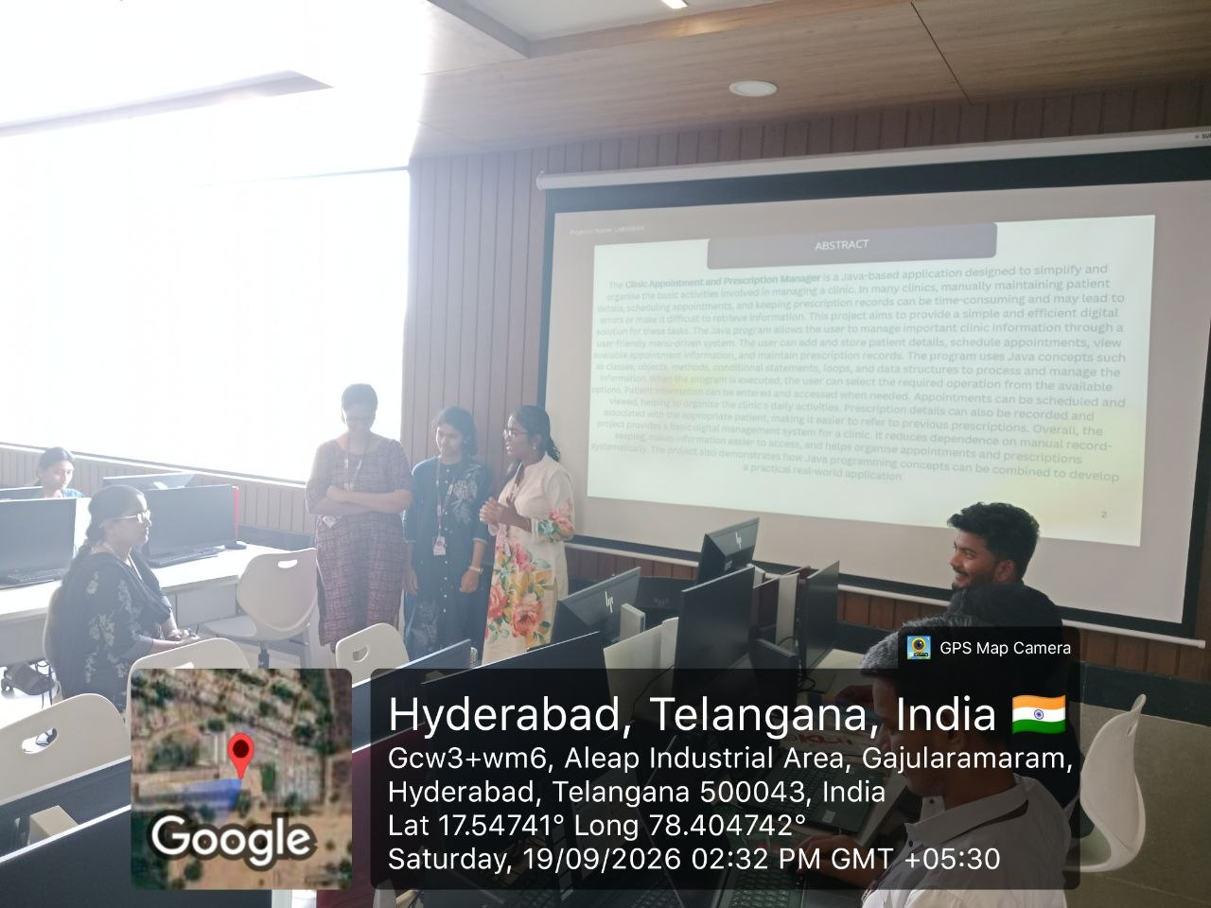
Geo Tag Photo and git hub link
https://github.com/vaishnavikolli471-png/JAVA-PROJECT-SEC-11-CLUSTER-3-PROJECT-8
GEO-TAGGED PROJECT PHOTO
GITHUB REPOSITORY

Slide 13








